Slide 1
Image Classification of Plant Pathology
Group Members:
Jinyi Shang
Yu Cao

Slide 2
Content
◆ Background
◆ Data Preprocessing
◆ Model (VGG16, ResNet)
◆ Result
◆ Conclusion and Potential Problem

Slide 3
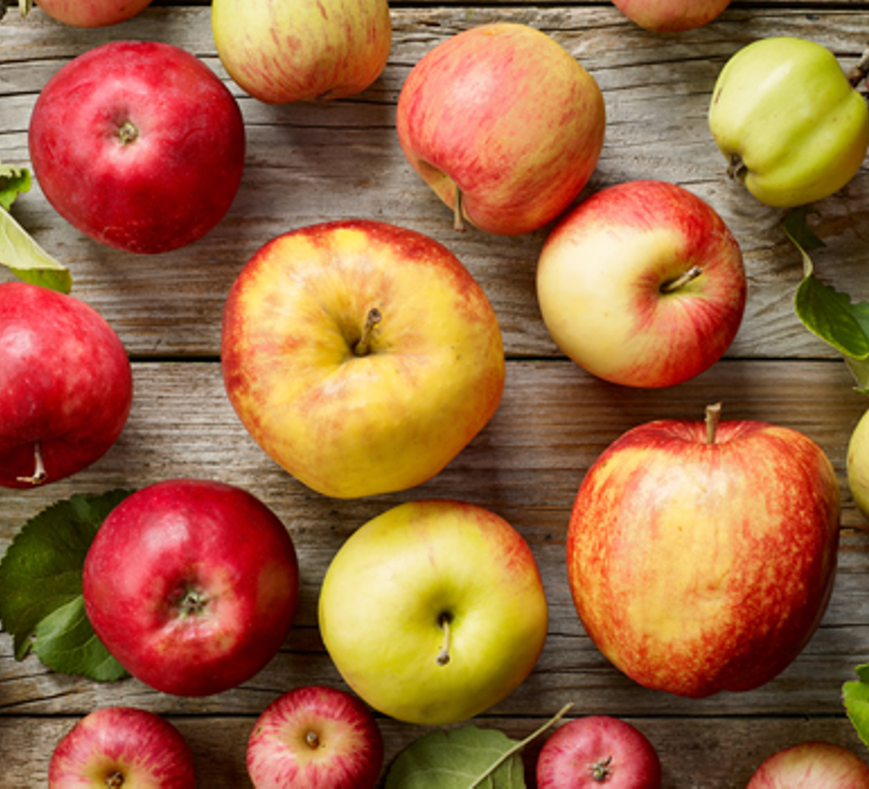
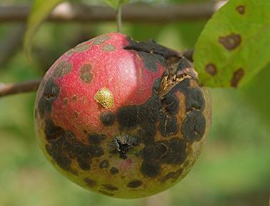
Background
Apple: one of the most important temperate fruit crops in the world.
Improve people’s immunity
Bring benefits to orchard workers
Early Disease Detection!!!
Current: Manual scouting -- Time & Error
This report: Deep learning
Leaf Diseases

Slide 4
Dataset
Disease | Counts
scab | 4826
healthy | 4624
frog_eye_leaf_spot | 3181
rust | 1860
complex | 1602
powdery_mildew | 1184
scab frog_eye_leaf_spot | 686
scab frog_eye_leaf_spot complex | 200
frog_eye_leaf_spot complex | 165
rust frog_eye_leaf_spot | 120
rust complex | 97
powdery_mildew complex | 87
Plant Pathology 2021-FGVC8 challenge competition in Kaggle
The original train.csv file contains 18632 images:
12 categories & imbalance!
Data Source:
https://www.kaggle.com/c/plant-pathology-2021-fgvc8/data?select=train.csv

Slide 5
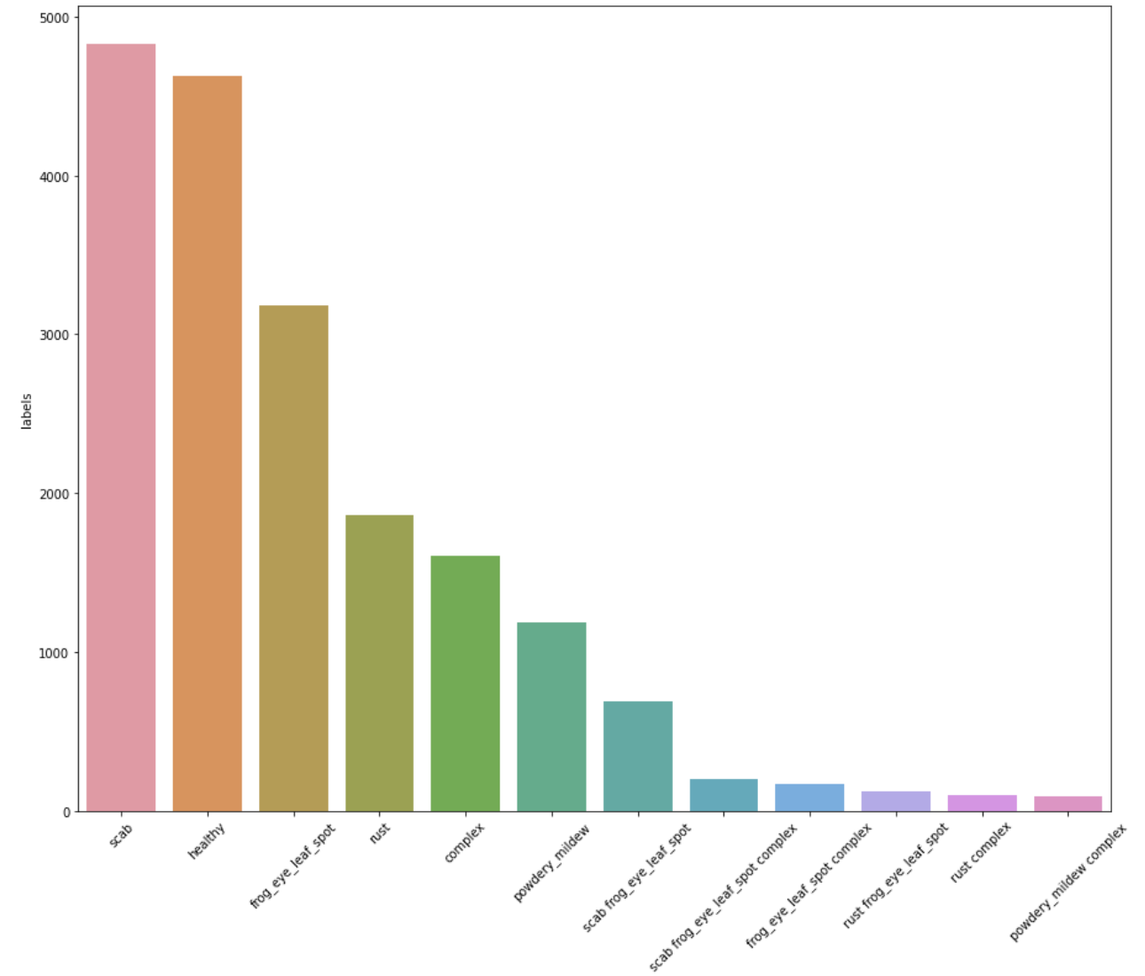
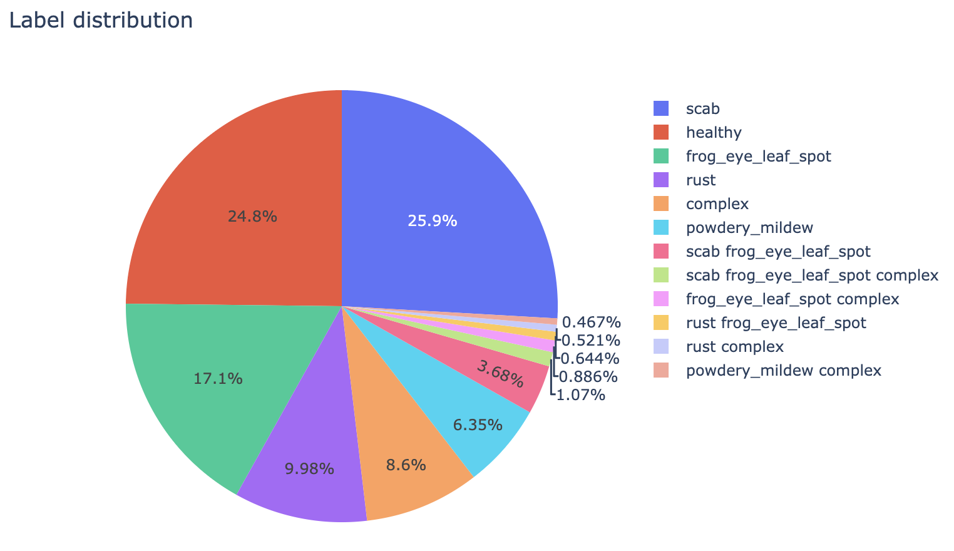
Image Source:
https://www.kaggle.com/praveengovi/plant-pathology-detail-eda-pytorch

Slide 6
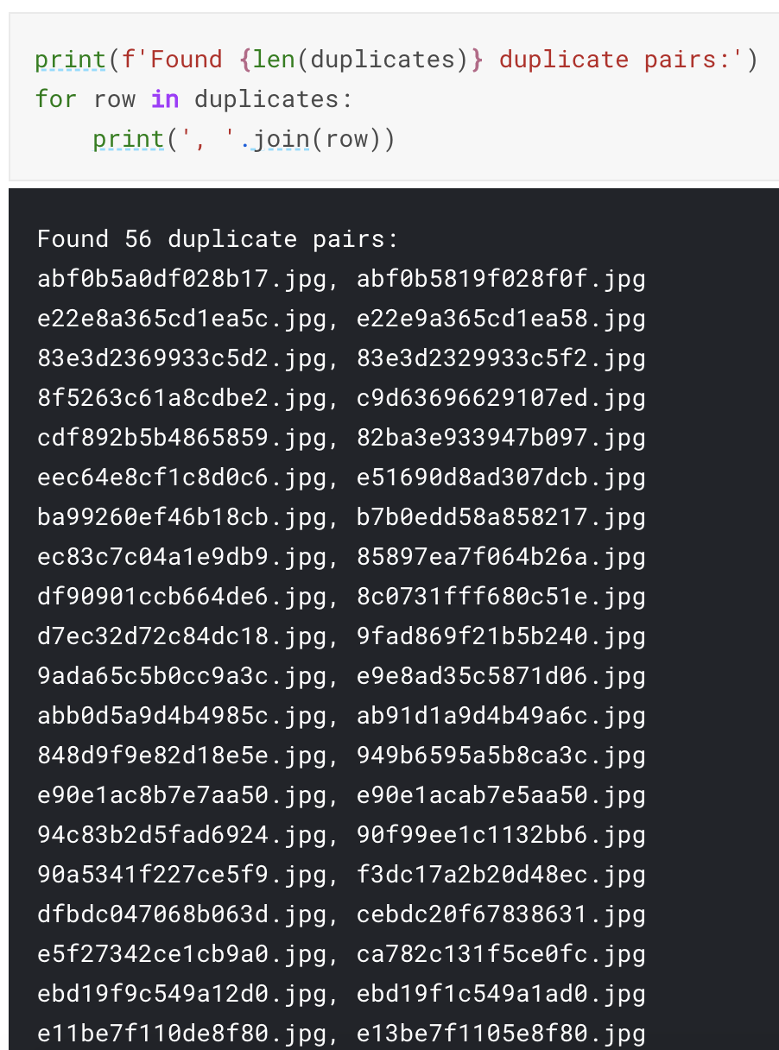
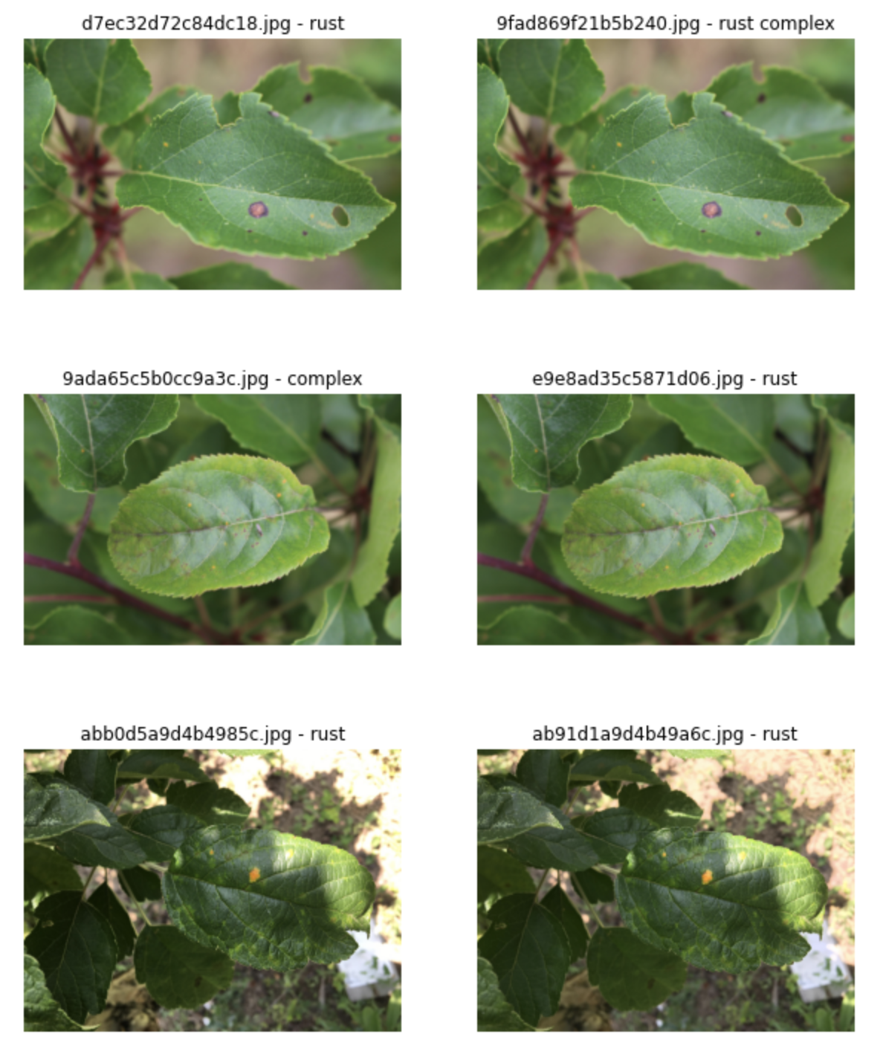
Duplicate
More than 50 duplicates pairs:
Reference:
https://www.kaggle.com/nickuzmenkov/pp2021-duplicates-revealing/output

Slide 7
Data Expansion
pixel_level transform
spatial_level transform
Package: albumentations
Two expanded dataset: 1, pixel_level + spatial_level
2, Only spatial_level

Slide 8
Data Expansion
Pixel-level transforms will change just an input image and will leave any additional targets such as masks, bounding boxes, and keypoints unchanged. Usually PLT will add noise to the original image.

Slide 9
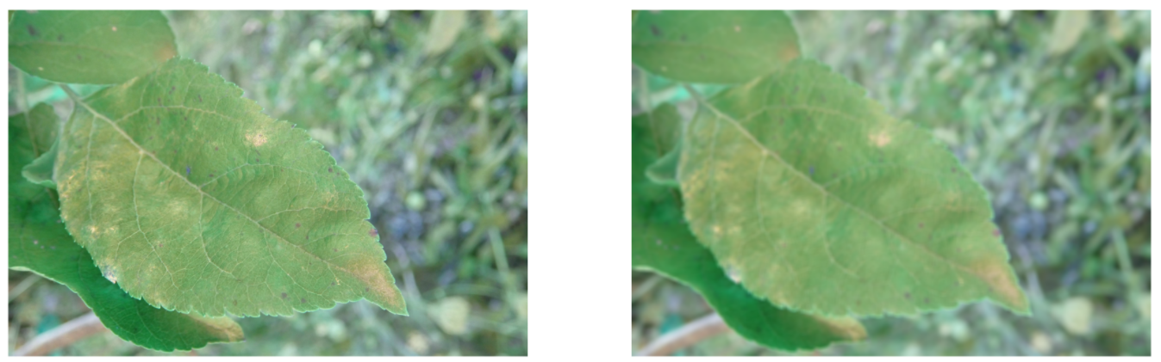
Data Expansion
albumentations.Blur(blur_limit=50,p=1)

Slide 10
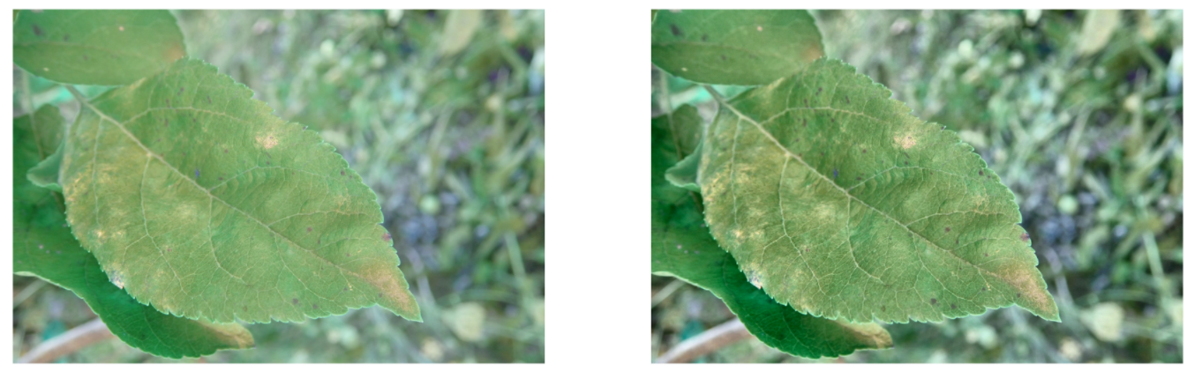
Data Expansion
albumentations.CLAHE(clip_limit=4.0, tile_grid_size=(8,8), p=1)

Slide 11
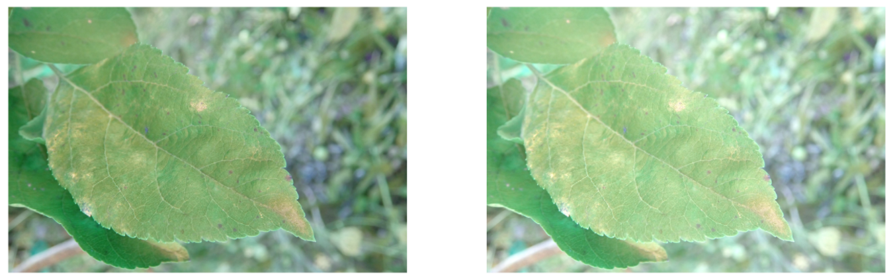
Data Expansion
albumentations.RandomBrightness(p=1)

Slide 12
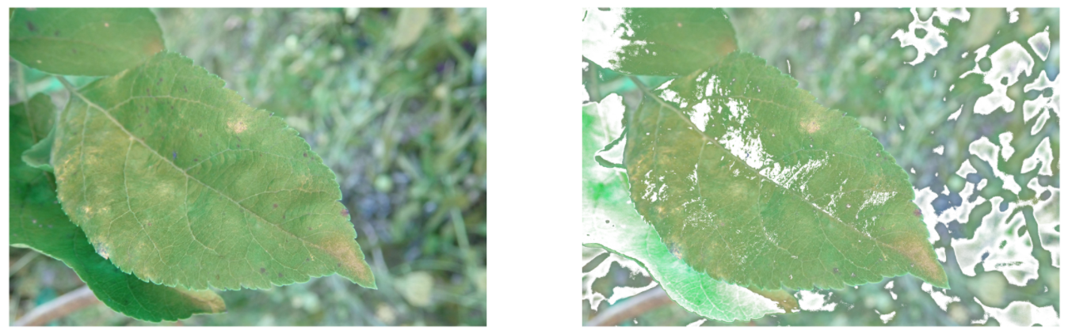
Data Expansion
albumentatiion..RandomSnow(p=1)

Slide 13
Data Expansion
Others: ColorJitter, FancyPCA, RandomFog, RGBShift and etc
add noise ==============> prevent overfitting
Spatial-level transforms will simultaneously change both an input image as well as additional targets such as masks, bounding boxes, and keypoints. Usually SLT will not add noise to the original image.

Slide 14
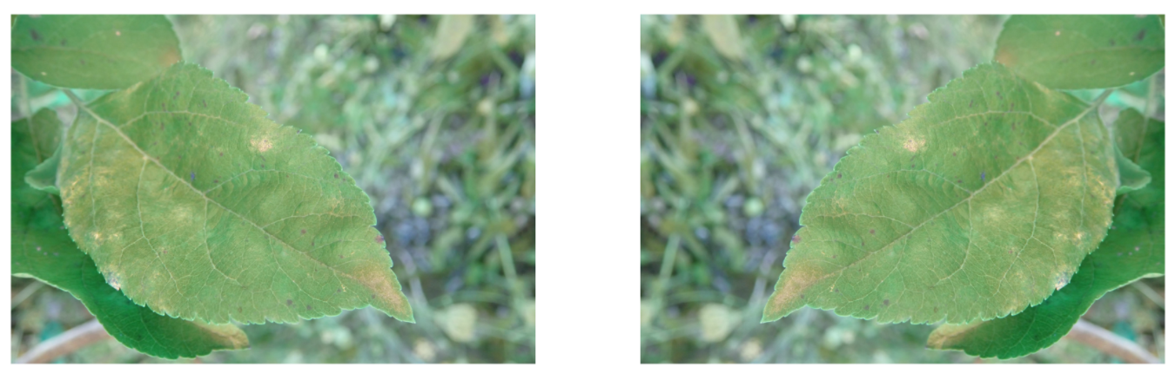
Data Expansion
albumentations.Flip(p=1)

Slide 15
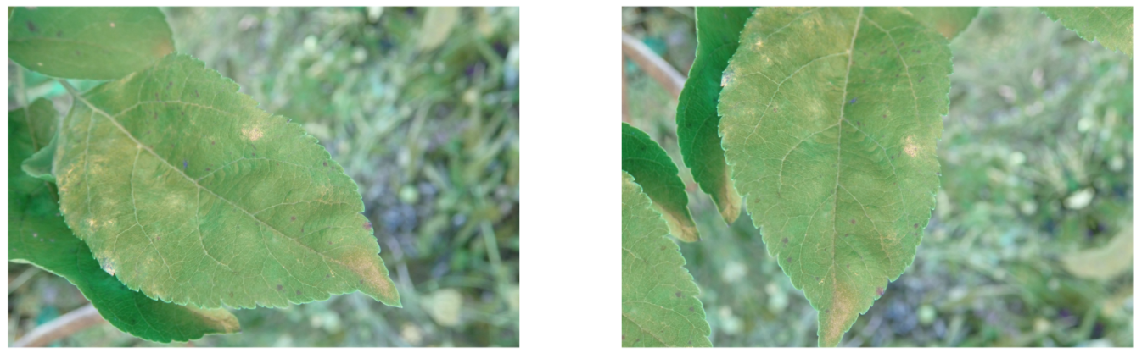
Data Expansion
albumentations.Rotate(p=1)

Slide 16
First expanded dataset:
pixel_level + spatial_level:
A.Compose(
[A.OneOf([A.CLAHE(clip_limit=4.0, tile_grid_size=(8,8), p=1),
``````],p=1),
A.OneOf([A.HorizontalFlip(p=1),
```````],p=1),
A.ShiftScaleRotate(p=1),
A.Resize(256,256)])
Before: 14000
After: 44000 of images

Slide 17
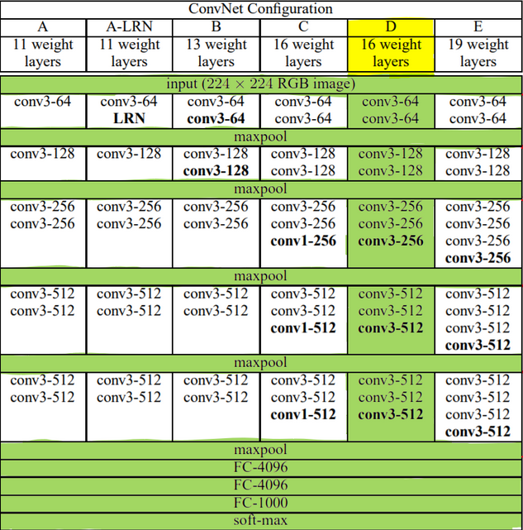
Model VGG16
13 CONV Layers +3 FC Layers

Slide 18
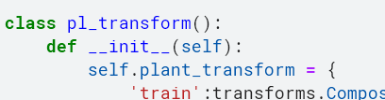
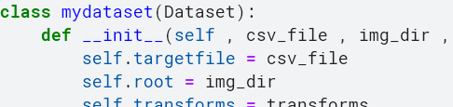
Data Pipeline and Model Configuration
Define customized transform class
Define customized dataset

Slide 19
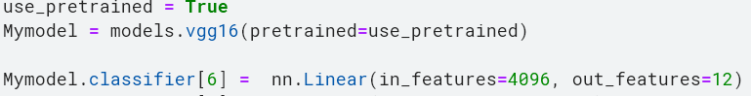
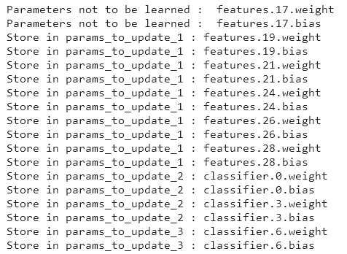
Load model
Fine tuning

Slide 20
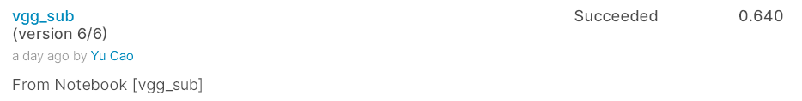
Local f1_score:
LB f1_score:

Slide 21
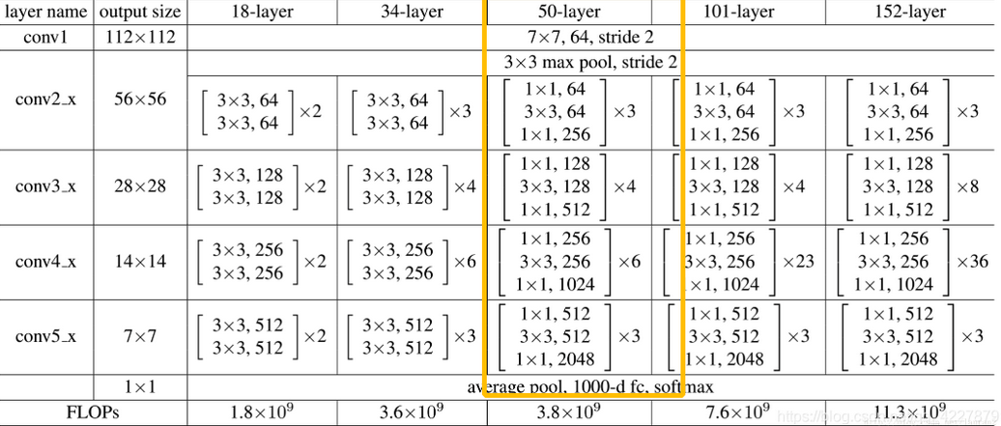
Model Resnet50

Slide 22
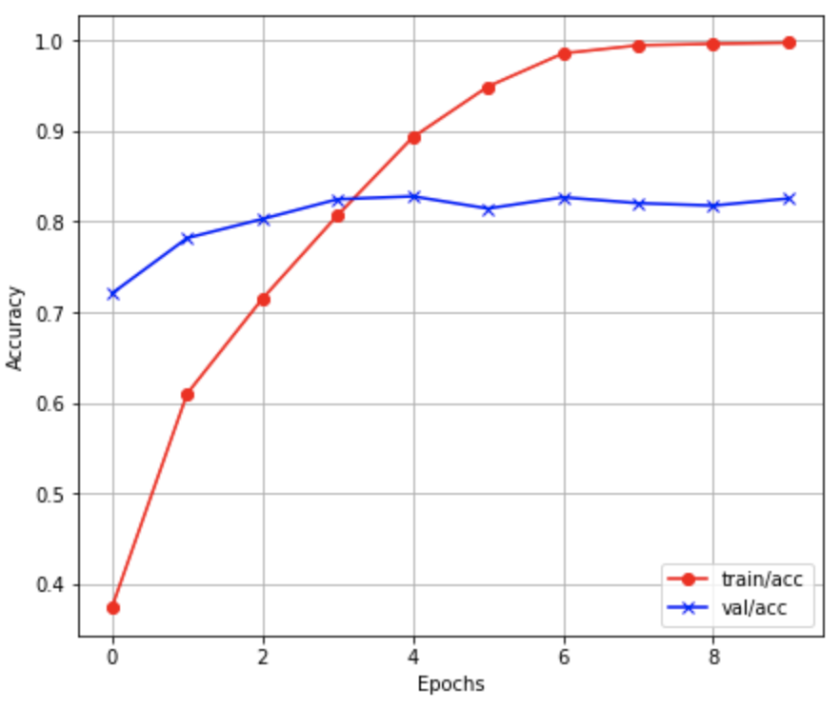
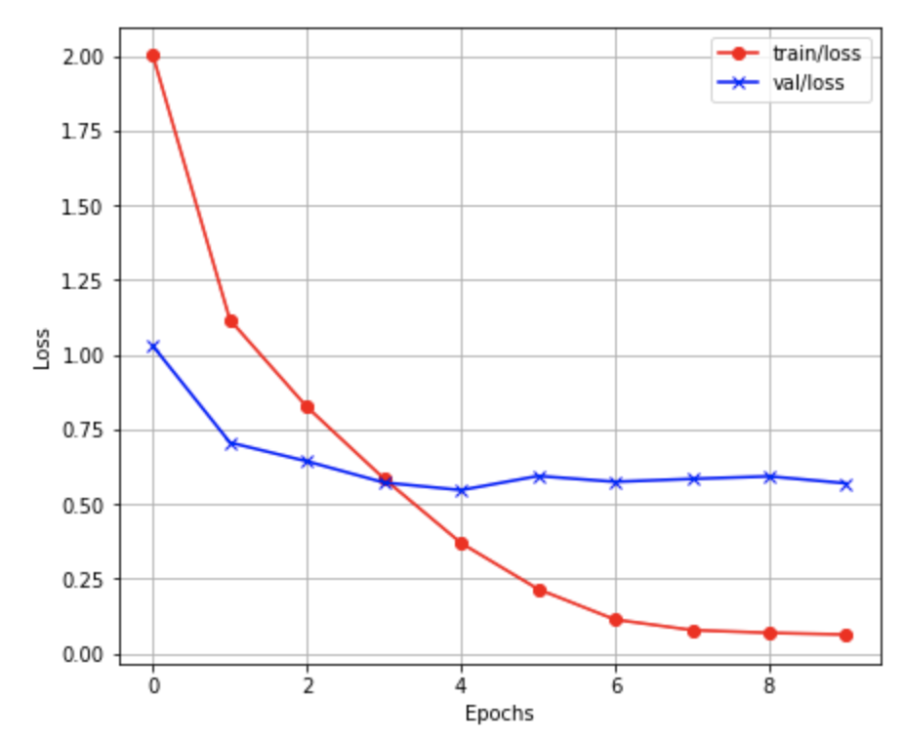
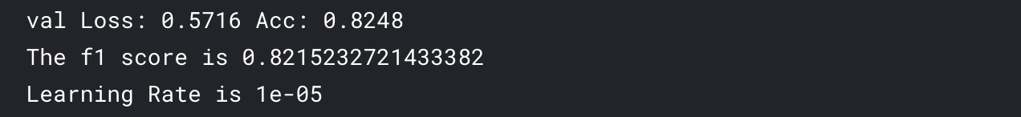
Result

Slide 23
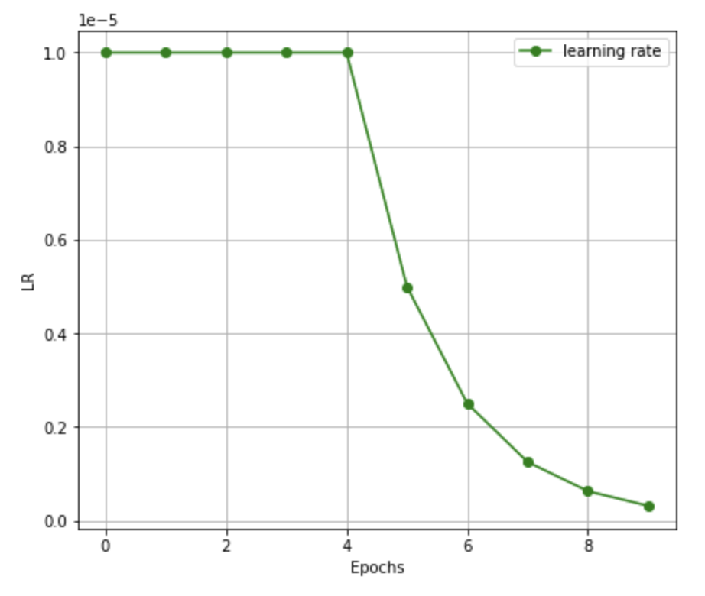
Learning Rate -- ReduceLROnPlateau()

Slide 24
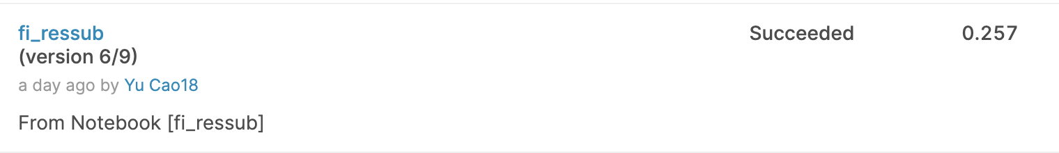
Potential Problem
1, Too much noise
2, overfitting
3, data distribution is different between train and test set
4, validation loss is smaller than train loss

Slide 25
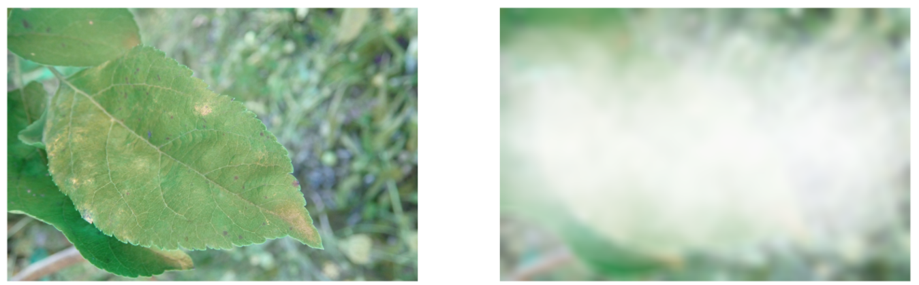
Bad pixel transform

Slide 26
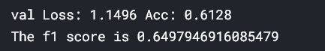

Slide 27
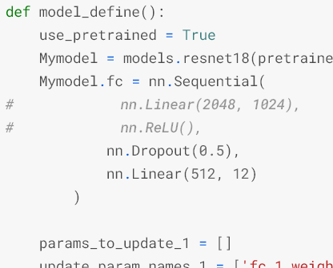
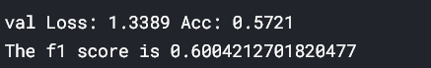
Overfitting

Slide 28
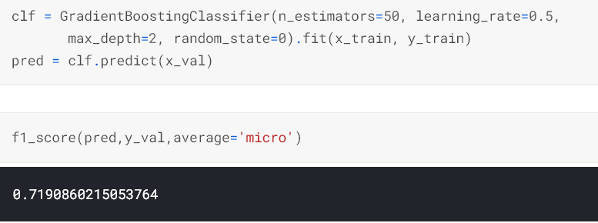
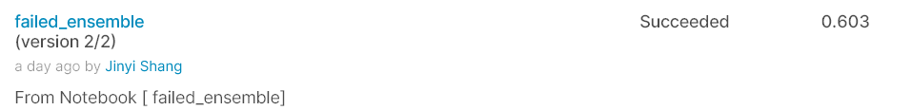
Ensemble
stacking
train

Slide 29
Reference
[1] “Plant Pathology 2021 - FGVC8.” Kaggle, www.kaggle.com/c/plant-pathology-2021-fgvc8.
[2] Brownlee, Jason. “A Gentle Introduction to Transfer Learning for Deep Learning.” Machine Learning Mastery, 16 Sept. 2019, machinelearningmastery.com/transfer-learning-for-deep-learning/#:~:text=Transfer learning is a machine,model on a second task.&text=Common examples of transfer learning,your own predictive modeling problems.
[3] “13.2. Fine-Tuning¶ Colab [Mxnet] Open the Notebook in Colab Colab [Pytorch] Open the Notebook in Colab Colab [Tensorflow] Open the Notebook in Colab.” 13.2. Fine-Tuning - Dive into Deep Learning 0.16.3 Documentation, d2l.ai/chapter_computer-vision/fine-tuning.html.
[4] Huilgol, Purva. “Accuracy vs. F1-Score.” Medium, Analytics Vidhya, 24 Aug. 2019, medium.com/analytics-vidhya/accuracy-vs-f1-score-6258237beca2.
[5] Nickuzmenkov. “PP2021 - Duplicates Revealing.” Kaggle, Kaggle, 6 Apr. 2021, www.kaggle.com/nickuzmenkov/pp2021-duplicates-revealing.
[6] Kuboko. “PP2021_PyTorch_VGG-16_Fine-tune_ Inference.” Kaggle, Kaggle, 25 Mar. 2021, www.kaggle.com/kuboko/pp2021-pytorch-vgg-16-fine-tune-inference.
[7] Thapa, R., Zhang, K., Snavely, N., Belongie, S., & Khan, A. (2020). The Plant Pathology Challenge 2020 data set to classify foliar disease of apples. Applications in Plant Sciences, 8(9). doi:10.1002/aps3.11390
[8] Compendium of Apple and Pear Diseases and Pests, Second Edition. (2014). doi:10.1094/9780890544334
[9] Praveengovi. (2021, April 19). Plant Pathology-Detail-EDA Pytorch. Retrieved from https://www.kaggle.com/praveengovi/plant-pathology-detail-eda-pytorch

